Slide 1
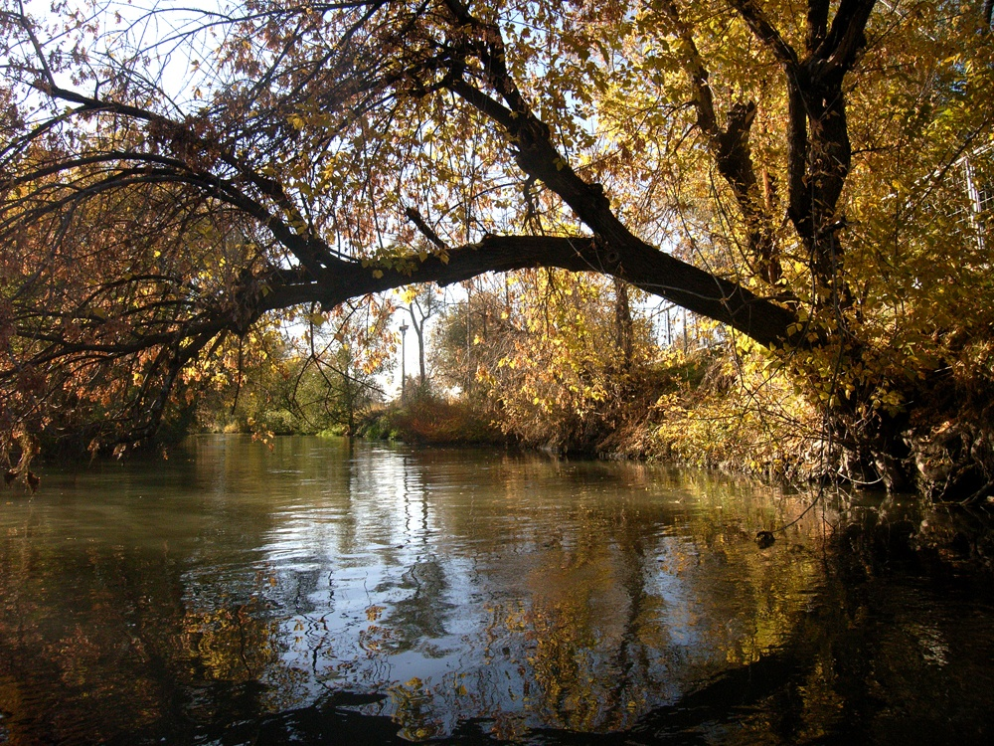
The Ecology of Riparian Restoration Ty Harrison
Photos by Ray Wheeler
1350 South

Slide 2
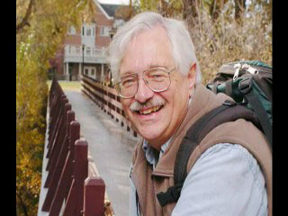
Who is Ty Harrison?
 | Born and raised on Jordan River Professional ecologist Emeritus professor, Westminster College Consultant for Jordan River Migratory Bird Reserve Restoration Project Member, Jordan River Commission’s Technical Advisory Committee Google “Ty Harrison” to visit web page

Slide 3
Major Questions
Who killed the Jordan River?
Why does the Jordan River need restoration?
Past destruction of habitat for migratory birds and other urban wildlife
Invasion of non-native plants
Lack of habitat connectivity
Need to increase biodiversity and environmental services (filtration, flood protection)
What is riparian and what is restoration?
How is it done?

Slide 4
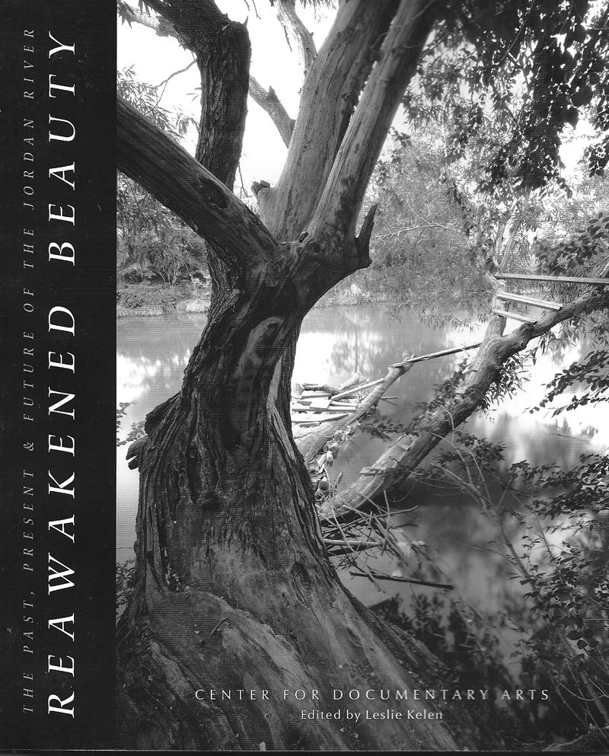
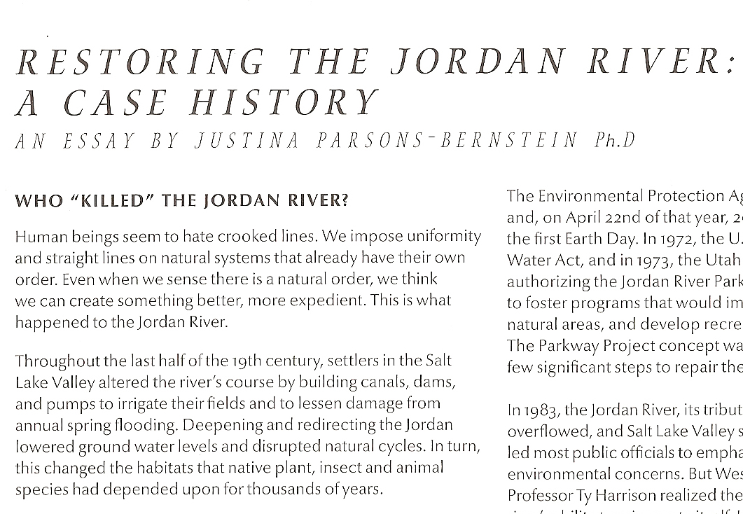
Who Killed the Jordan River

Slide 5
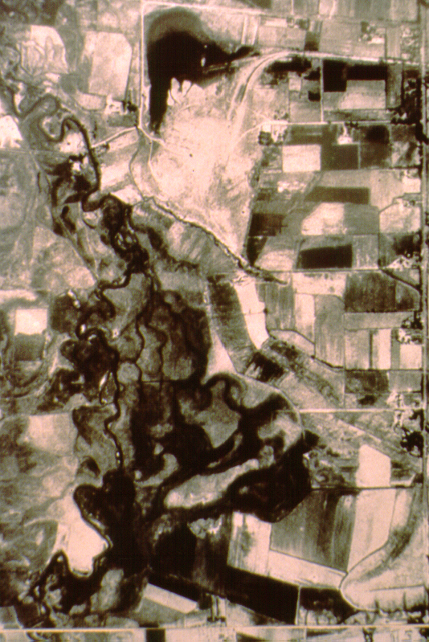
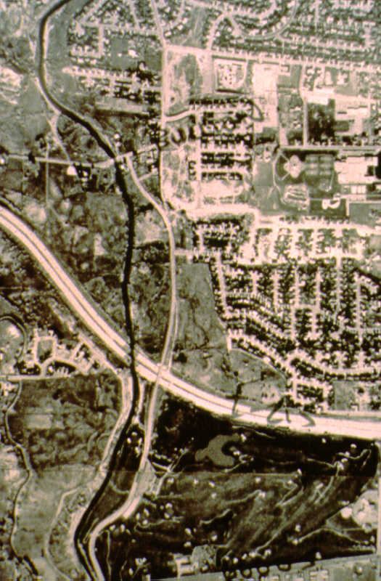
Boullion Street
6200 South, 1937
Boullion Street
•
6200 South, 1990
Old
Jordan
River
New
Jordan
River
I-215
I-215
Murray
Golf Course
Murray
Golf Course
Jordan River 1937
Jordan River 1990

Slide 6
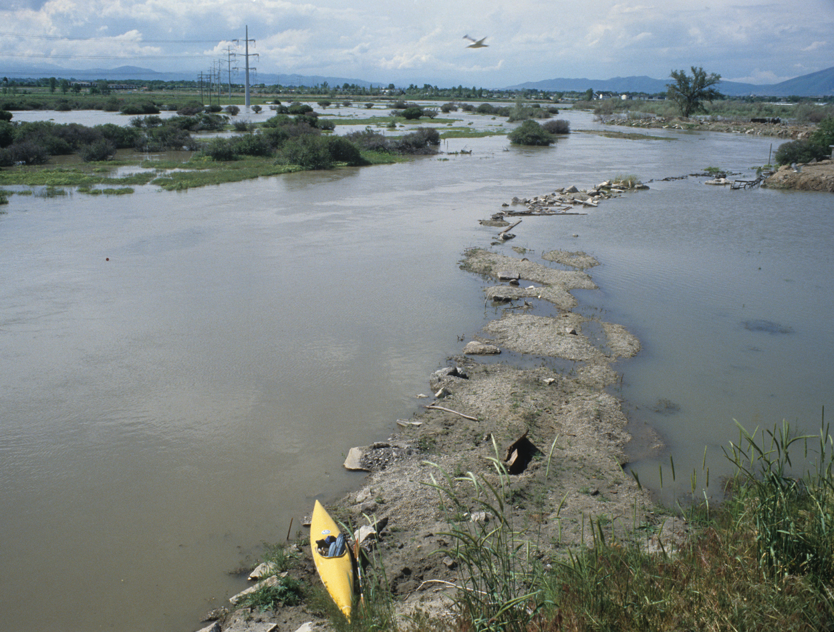
Jordan River flood, 1983, North Salt Lake
c. Ray Wheeler

Slide 7
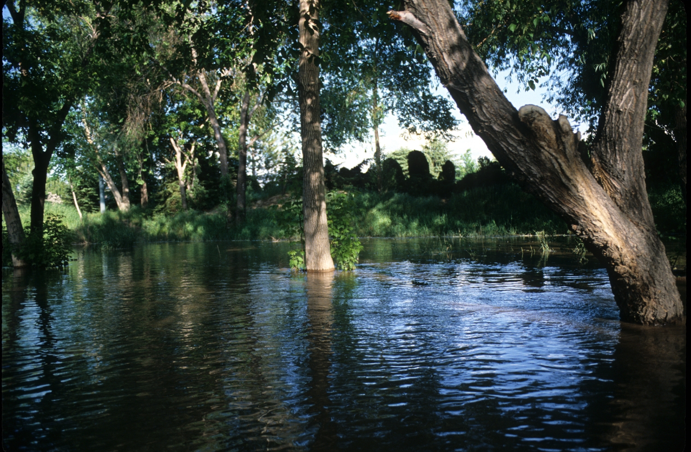
c. Ray Wheeler

Slide 8
Dredging the Jordan at 10600 S. in 1986-87

Slide 9
Historic A.W. Harrison farm (north end)

Slide 10
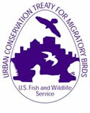
Why Restoration?
Urban Conservation Treaty for Migratory Birds
A program working with cities and partners to conserve migratory birds through education, hazard reductions, citizen science, conservation actions, and conservation and habitat improvement strategies in urban/suburban areas.
INTRODUCTION - Urban Bird Treaty Program The Urban Conservation Treaty for Migratory Birds (Urban Bird Treaty) program was created to help municipal governments conserve birds that live and nest in or overwinter or migrate through their cities. Launched in 1999, the first treaty was signed with New Orleans, and the second treaty was signed with Chicago. The treaties are a partnership agreement between a U.S. city and the U.S Fish and Wildlife Service (Service) to conserve migratory birds through education, habitat improvement and bird conservation actions.
http://www.fws.gov/migratorybirds/Partnerships/UrbanTreaty/urbantreaty.html

Slide 11
Jordan River Migratory Corridor

Slide 12
The Role of Natural Flooding in Riparian Forest Establishment
Person observation of native cottonwood and willow establishment after the 1983-84 “hundred year” flood on Harrison farm and elsewhere.
Cottonwoods and willow germinate only on bare mud during flood recession in June.
River channelization stops overbank flooding (except in the 100 year flood).
Ecological restoration by humans requires planting the native species and hastens the establishment of the riparian ecosystem.

Slide 13
Desired features for a successful riparian forest restoration
A large area with few “edges” (island biogeography)
Removal of “exotic” plant species
Re-planting of native trees and shrubs with ecological stratification or vegetation diversity
Proximity to ground water for rooting
Flood terrace reconstruction on dredge-steepened river banks

Slide 14
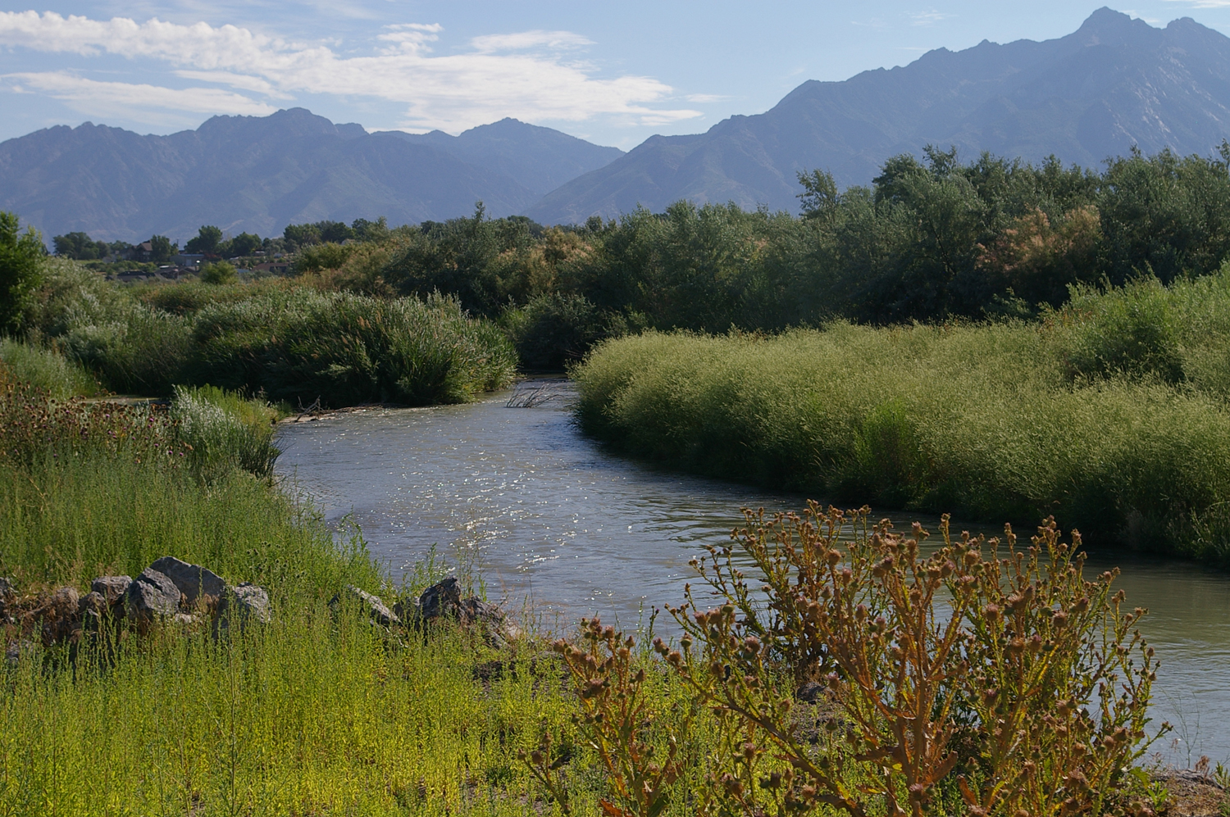
c. Anne-Marie Bernshaw

Slide 15
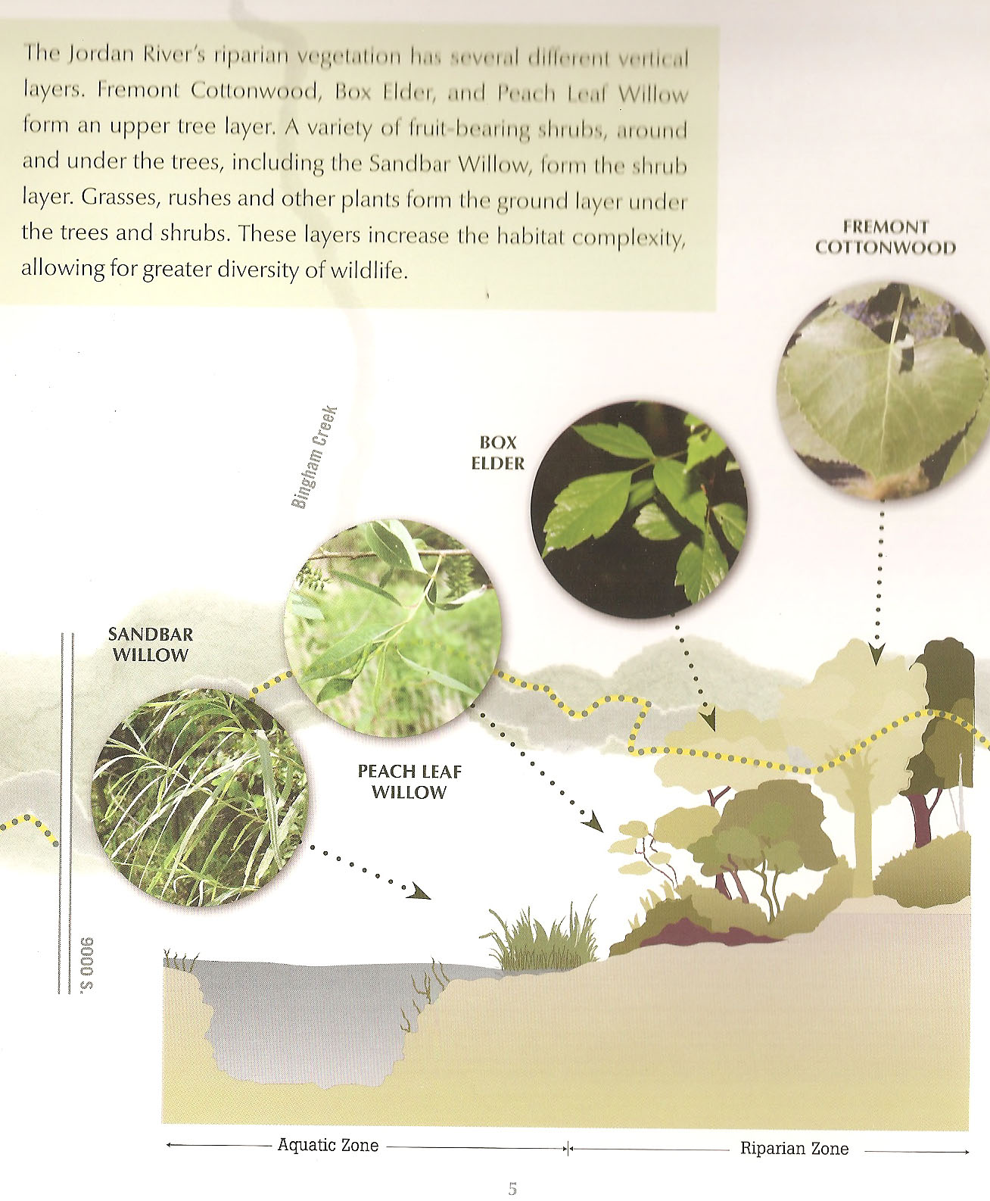

Slide 16
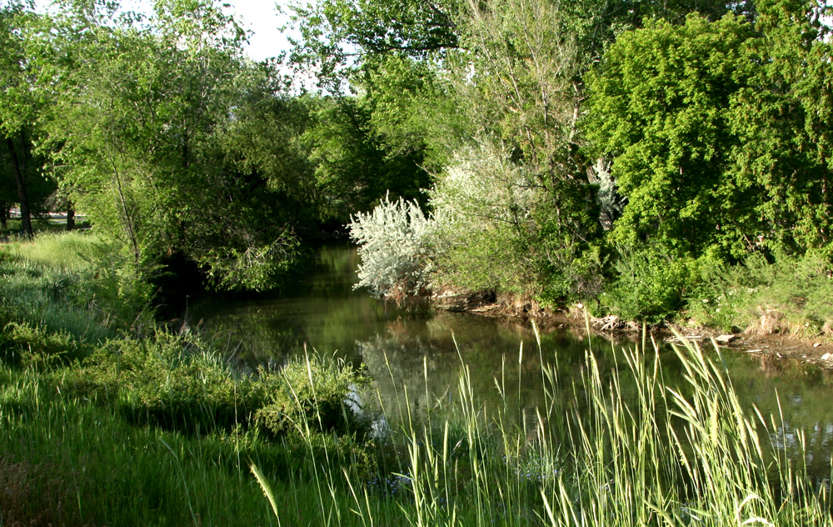
Yellow Breasted Chat: winters in
sub-tropical forests
Can the Chat live here?
Why not?
Can the chat live here?
Why?

Slide 17
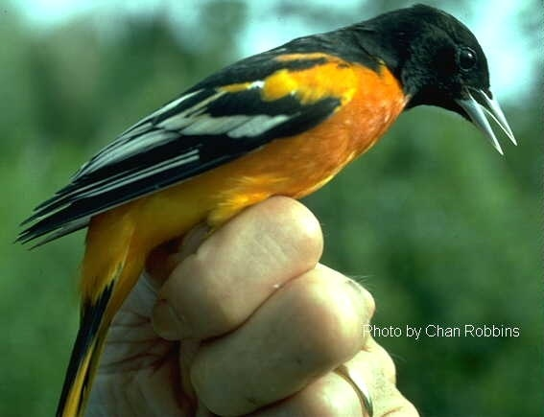
Goal: Attraction of Neotropical migratory birds such as the Bullock’s Oriole and habitat for resident wildlife

Slide 18
Jordan River Riparian Ecological Restoration Areas (south to north)
1. The Galena Open Space Complex (Draper)
http://www.ffsl.utah.gov/SovLands/Galena_cmp.pdf
2. Jordan River Migratory Bird Habitat Restoration Project (South Jordan)
http://www.treeutah.org/eco_restoration.htm
Bingham Junction Riverwalk Natural Area (Midvale)
(Important storm water filtration and river flood connection demonstration)
4. S. L. Co. Redwood NatureArea (West Valley City)
http://www.recreation.slco.org/parks/redwoodNatureArea/index.html
5. Bend-in-the-River (Salt Lake City) & S.L. City/County bank stabilization project
http://www.sa.utah.edu/bennion/bend/
http://www.slcgov.com/node/627
6. Proposed 9th South Oxbow Project

Slide 19
Jordan River Migratory Bird Reserve: A 17-year Project Willow Creek Restoration Time Line

Slide 20
Jordan River Migratory Bird Reserve: A 15 year Case Study 120 acres at 10600 S. 1 & ½ miles of east side river frontage

Slide 21
Non-native species removal and control (2000-2005)

Slide 22
10 year old planting of Golden Currant shrubs from 1997 Fairbourn Pasture planting

Slide 23
Willow Creek Re-alignment and planting after 2007

Slide 24
Willow Creek new channel planted with trees, shrubs, cattails, bullrushes

Slide 25
Waterfowl, shorebirds, deer and beaver immediately attracted to wetlands

Slide 26
2009 season Oriole nest in Fremont Cottonwood planted in 1999 (ten year old tree). Note willows behind.

Slide 27
Oriole nest in ten year-old Box Elder, woven with milkweed fibers and polypropylene from weed fabric

Slide 28
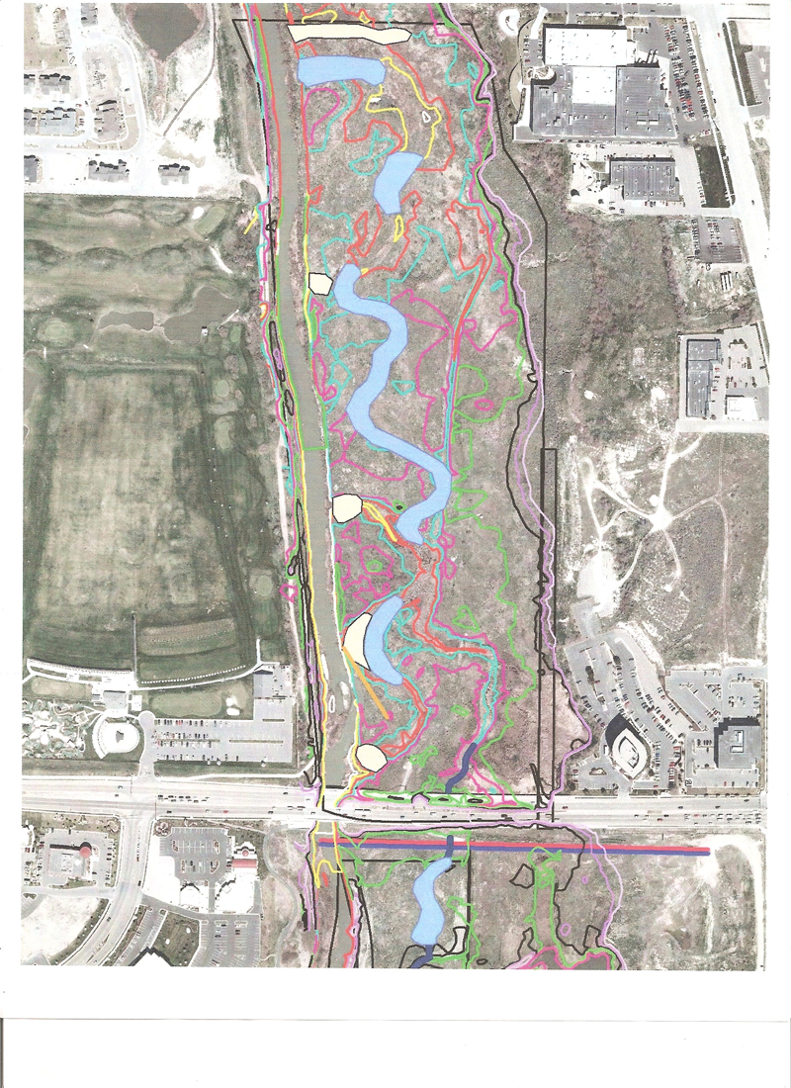
Future Willow Creek extension across Greenwood Pasture N. of 10600 S. in South Jordan

Slide 29
Issues for Riparian Restoration in Salt Lake County
Public awareness of restoration benefits (Blue Print Jordan River)
Countywide coordination and funding of restoration projects
Funding for long-term maintenance
Training for municipal employees in restoration and maintenance techniques
Understanding the role of riparian wetlands in best management practices for storm water

Slide 30
Natural Area Management Issues
Weed and exotic tree control
Location of public recreation trails away from wildlife habitat
Beaver management & control

Slide 31
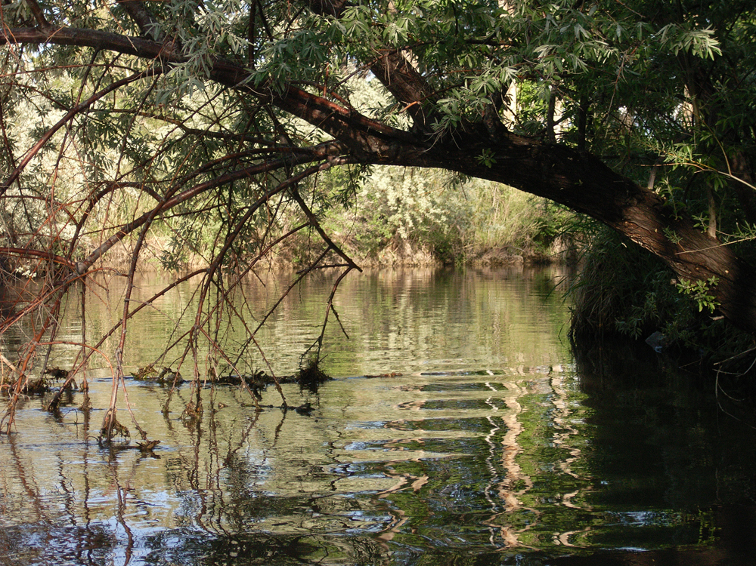
1000 South
c. Ray Wheeler

Slide 32
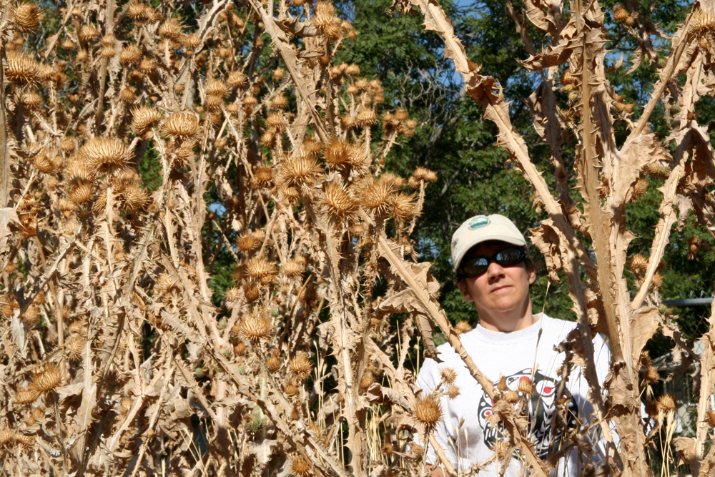
Scotch Thistle, 900 South

Slide 33
c. Ray Wheeler

Slide 34
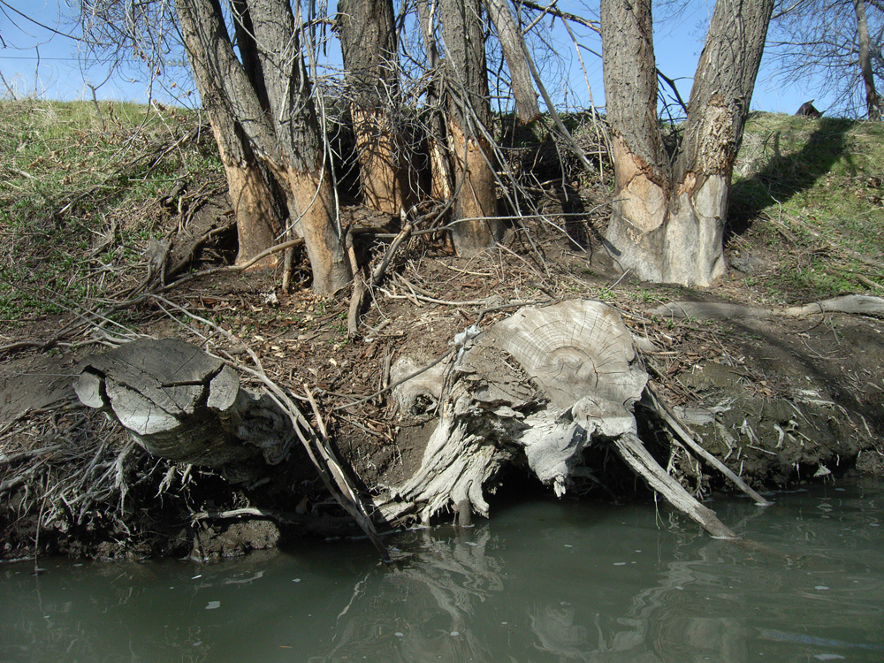
Below Fisher Mansion ~100 S
c. Ray Wheeler

Slide 35
Future Restoration Projects
Continuation of Jordan River Migratory Bird Reserve Project (Great Salt Lake Audubon)
West Jordan Wetland Restoration (90th S.) (U.S. Fish & Wildlife/West Jordan City/ etc.)
Salt Lake City’s Jordan River Restoration Project (Chevron)
Salt Lake City’s 9th South Oxbow Project

Slide 36
Jordan River Water Quality and Restoration Issues
Organic matter from urban storm drains may be polluting the river in Salt Lake City
Role of wetland filtration in removal of Nitrogen, Phosphorus and organic matter
A possible demonstration project at the 9th South Oxbow

Slide 37
Where does urban storm water and what it carries end up?

Slide 38
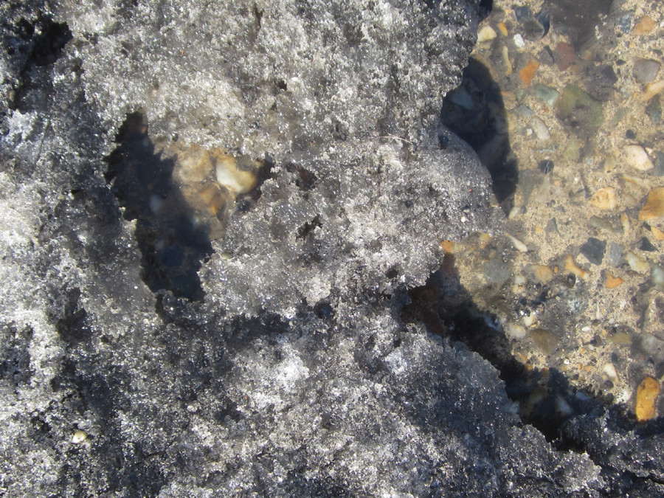
Possible Source of Urban Organic Matter Pollution in Storm Water

Slide 39
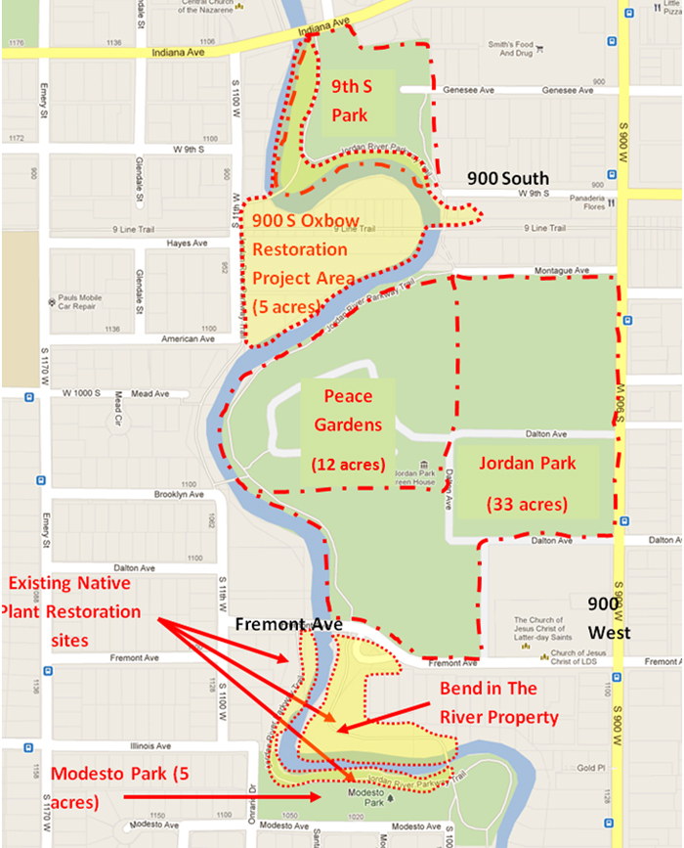
Proposed Ninth South Oxbow Riparian Restoration

Slide 40
Final Thoughts
More riverbank setbacks and re-vegetation projects are needed along the whole Jordan River.
Jordan River restoration projects need to plant more native shrubs and especially trees to improve and connect urban wildlife habitat.
A wetland filtration demonstration/education project needs to be designed for Salt Lake City’s urban storm drainage system. The 9th South Oxbow is an ideal site for this

Slide 41
We know how to do all of this. All we need is the political will and the funding.

